Slide 1




Object-Oriented Patterns & Frameworks
Dr. Douglas C. Schmidt
d.schmidt@vanderbilt.edu
www.dre.vanderbilt.edu/~schmidt
Professor of EECS Vanderbilt University Nashville, Tennessee

Slide 2
Goals of this Presentation
Show by example how patterns & frameworks can help to
Codify good OO software design & implementation practices
distill & generalize experience
aid to novices & experts alike
Give design structures explicit names
common vocabulary
reduced complexity
greater expressivity
Capture & preserve design & implementation knowledge
articulate key decisions succinctly
improve documentation
Facilitate restructuring/refactoring
patterns & frameworks are interrelated
enhance flexibility, reuse, & productivity
AbstractService
service
Client
Proxy
Service
service
1
1
service
class Reactor {
public:
/// Singleton access point.
static Reactor *instance (void);
/// Run event loop.
void run_event_loop (void);
/// End event loop.
void end_event_loop (void);
/// Register @a event_handler
/// for input events.
void register_input_handler
(Event_Handler *eh);
/// Remove @a event_handler
/// for input events.
void remove_input_handler
(Event_Handler *eh);

Slide 3
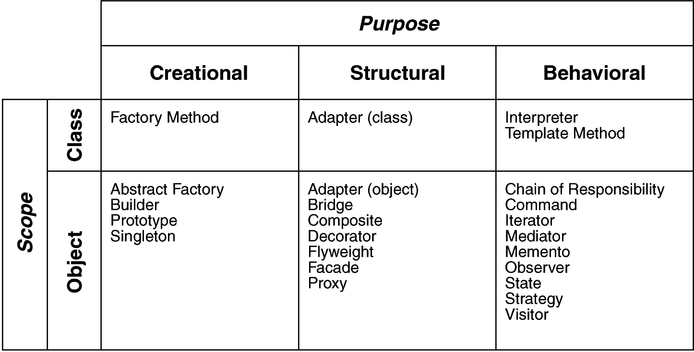
Tutorial Overview
Part I: Motivation & Concepts
The issue
What patterns & frameworks are
What they’re good for
How we develop/categorize them
Part II: Case Study
Use patterns & frameworks to build an expression tree application
Demonstrate usage & benefits
Part III: Wrap-Up
Life beyond the GoF book, observations, caveats, concluding remarks, & additional references
Binary
Nodes
Unary
Node
Leaf
Nodes

Slide 4
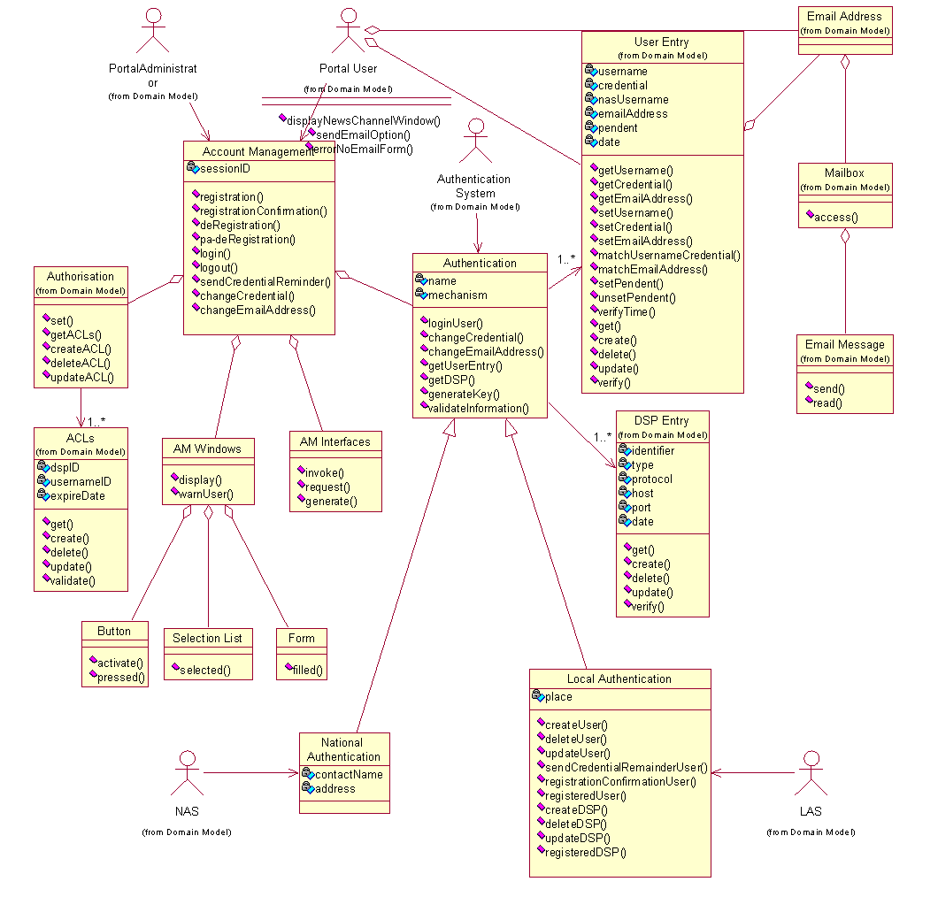
Part I: Motivation & Concepts
OOD methods emphasize design notations
Fine for specification & documentation

Slide 5
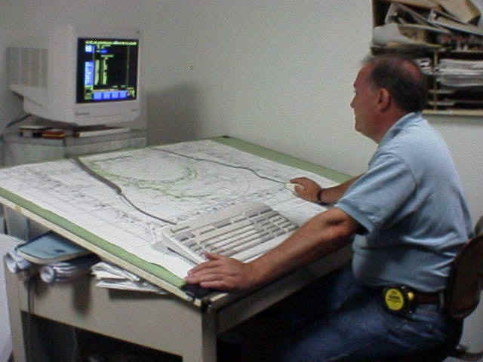
Part I: Motivation & Concepts
OOD methods emphasize design notations
Fine for specification & documentation
But OOD is more than just drawing diagrams
Good draftsmen are not necessarily good architects!

Slide 6
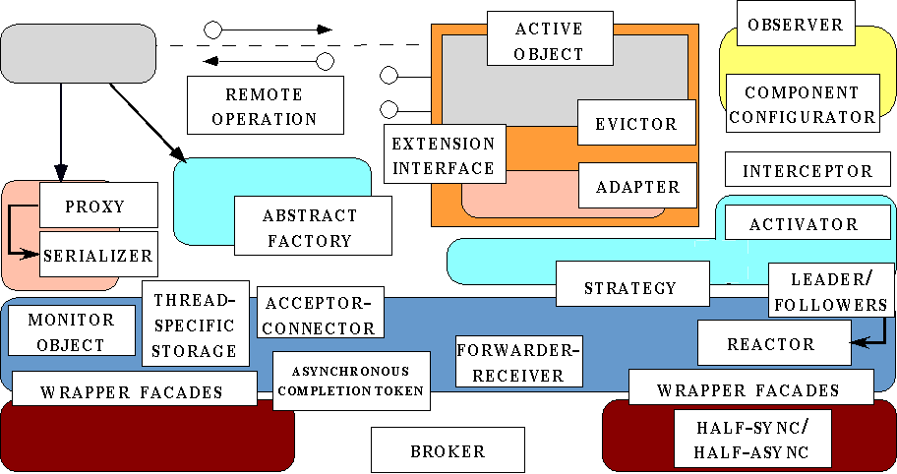
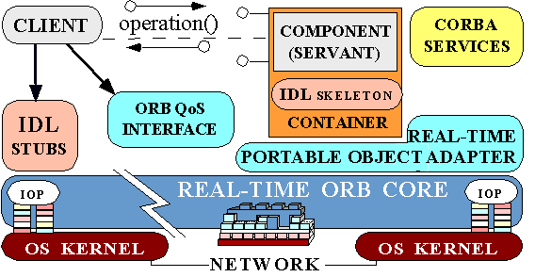
Part I: Motivation & Concepts
OOD methods emphasize design notations
Fine for specification & documentation
But OOD is more than just drawing diagrams
Good draftsmen are not necessarily good architects!
Good OO designers rely on lots of experience
At least as important as syntax
Most powerful reuse combines design & code reuse
Patterns: Match problem to design experience
Frameworks: Reify patterns within a domain context
Subject
*
Observer
state
observerList
update
attach
detach
notify
setData
getData
ConcreteObserver
update
doSomething
state = X;
notify();
for all observers in observerList do
update();
s->getData()

Slide 7

Recurring Design Structures
Well-designed OO systems exhibit recurring structures that promote
Abstraction
Flexibility
Modularity
Elegance
Therein lies valuable design knowledge
Problem: capturing, communicating, applying, & preserving this knowledge without undue time, effort, & risk

Slide 8
A Pattern…
Abstracts & names a recurring design structure
Comprises class and/or object
Dependencies
Structures
Interactions
Conventions
Specifies the design structure explicitly
Is distilled from actual design experience
AbstractService
service
Client
Proxy
Service
service
1
1
service
The Proxy Pattern
Presents solution(s) to common (software) problem(s) arising within a context

Slide 9
Four Basic Parts of a Pattern
Name
Problem (including “forces” & “applicability”)
Solution (both visual & textual descriptions)
Consequences & trade-offs of applying the pattern
AbstractService
service
Client
Proxy
Service
service
1
1
service
The Proxy Pattern
Key characteristics of patterns include:
Language- & implementation-independent
“Micro-architecture”
i.e., “society of objects”
Adjunct to existing methodologies
e.g., RUP, Fusion, SCRUM, etc.

Slide 10

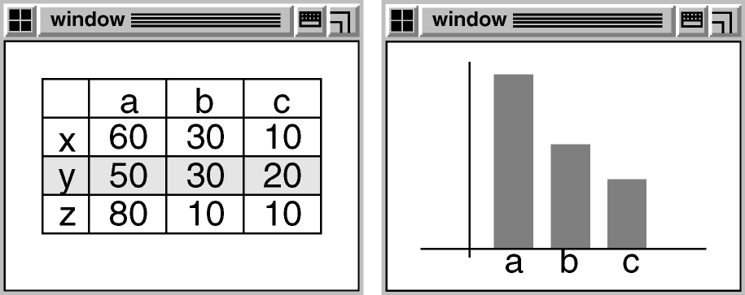
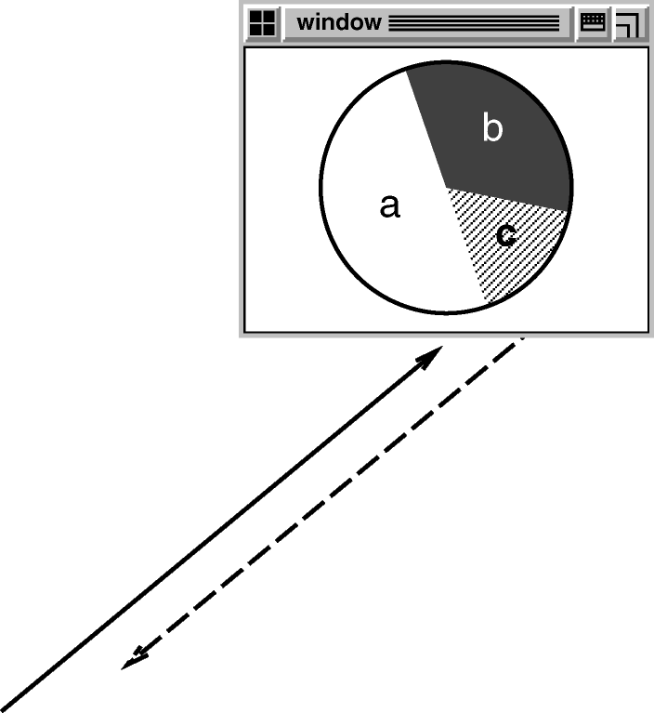
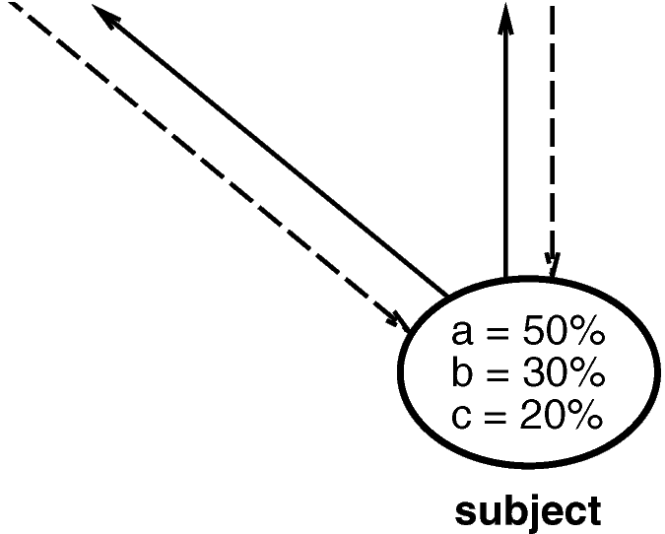
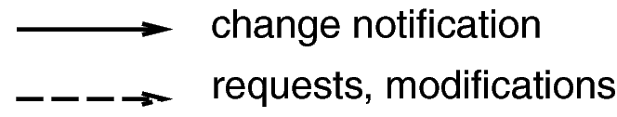
Example: Observer

Slide 11
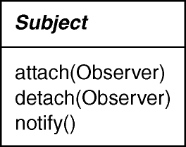
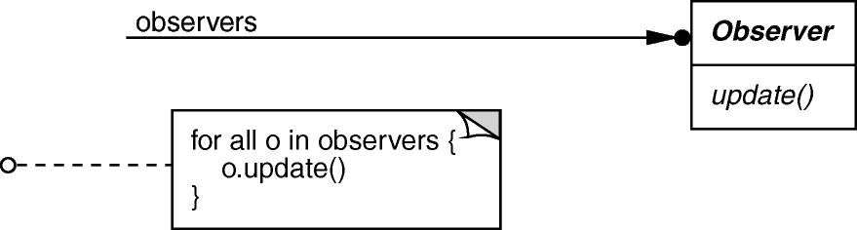
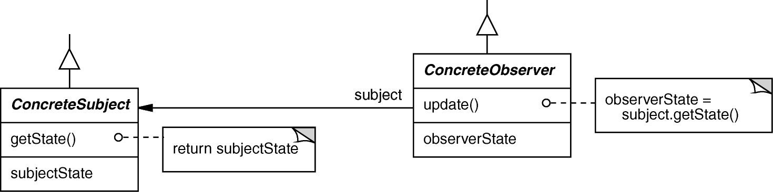
Observer object behavioral
Intent
define a one-to-many dependency between objects so that when one object changes state, all dependents are notified & updated
Applicability
an abstraction has two aspects, one dependent on the other
a change to one object requires changing untold others
an object should notify unknown other objects
Structure

Slide 12
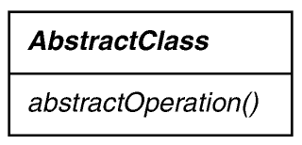
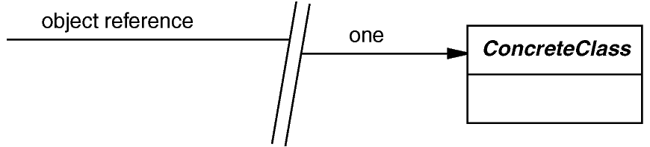
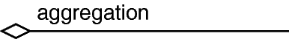


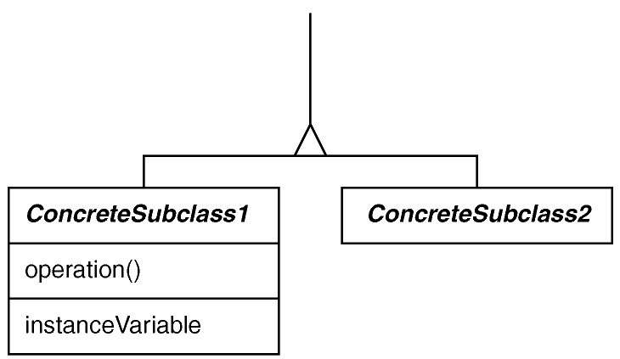
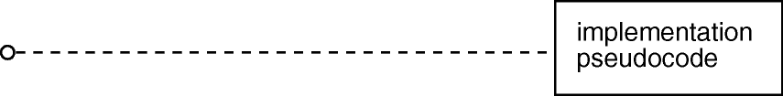
Modified UML/OMT Notation

Slide 13
Observer object behavioral
class ProxyPushConsumer : public // …
virtual void push (const CORBA::Any &event) {
for (std::vector<PushConsumer>::iterator i
(consumers.begin ()); i != consumers.end (); i++)
(*i).push (event);
}
class MyPushConsumer : public // ….
virtual void push
(const CORBA::Any &event) { /* consume the event. */ }
CORBA Notification Service example using C++ Standard Template Library (STL) iterators (which is an example of the Iterator pattern from GoF)

Slide 14
Observer object behavioral
Consequences
modularity: subject & observers may vary independently
extensibility: can define & add any number of observers
customizability: different observers offer different views of subject
unexpected updates: observers don’t know about each other
update overhead: might need hints or filtering
Implementation
subject-observer mapping
dangling references
update protocols: the push & pull models
registering modifications of interest explicitly
Known Uses
Smalltalk Model-View-Controller (MVC)
InterViews (Subjects & Views, Observer/Observable)
Andrew (Data Objects & Views)
Smart phone event frameworks (e.g., Symbian, Android, iPhone)
Pub/sub middleware (e.g., CORBA Notification Service, Java Message Service, DDS)
Mailing lists

Slide 15
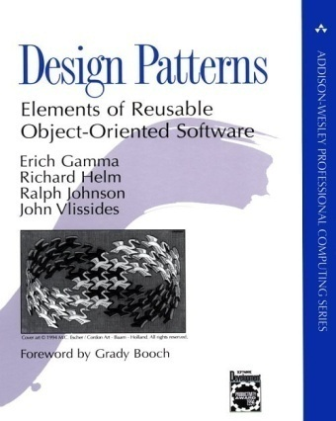
Design Space for GoF Patterns
√
√
√
√
√
√
√
√
√
√
√
√
√
√
√
√
√
Scope: domain over which a pattern applies
Purpose: reflects what a pattern does

Slide 16
GoF Pattern Template (1st half)
Intent
short description of the pattern & its purpose
Also Known As
Any aliases this pattern is known by
Motivation
motivating scenario demonstrating pattern’s use
Applicability
circumstances in which pattern applies
Structure
graphical representation of pattern using modified UML notation
Participants
participating classes and/or objects & their responsibilities

Slide 17
GoF Pattern Template (2nd half)
...
Collaborations
how participants cooperate to carry out their responsibilities
Consequences
the results of application, benefits, liabilities
Implementation
pitfalls, hints, techniques, plus language-dependent issues
Sample Code
sample implementations in C++, Java, C#, Python, Smalltalk, C, etc.
Known Uses
examples drawn from existing systems
Related Patterns
discussion of other patterns that relate to this one

Slide 18
Benefits & Limitations of Patterns
Benefits
Design reuse
Uniform design vocabulary
Enhance understanding, restructuring, & team communication
Basis for automation
Transcends language-centric biases/myopia
Abstracts away from many unimportant details
Limitations
Require significant tedious & error-prone human effort to handcraft pattern implementations design reuse
Can be deceptively simple uniform design vocabulary
May limit design options
Leaves important (implementation) details unresolved
Addressing the limitations of patterns requires more than just design reuse

Slide 19
Overview of Frameworks
Frameworks exhibit “inversion of control” at runtime via callbacks
Frameworks provide integrated domain-specific structures & functionality
Frameworks are “semi-complete” applications
Application-specific functionality
Scientific
Visualization
Mission Computing
E-commerce
GUI
Networking
Database

Slide 20





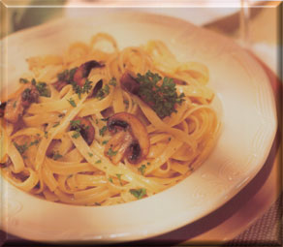
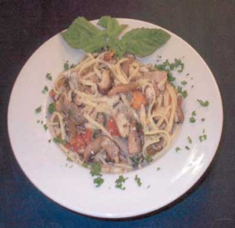
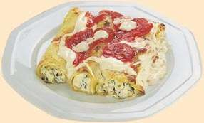
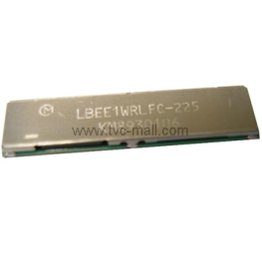
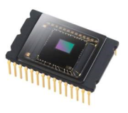
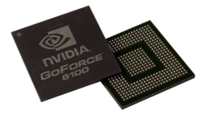
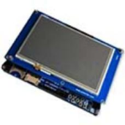
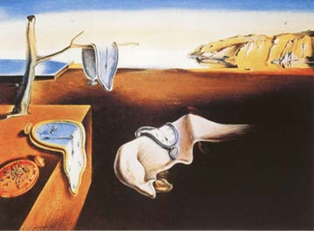
Motivation for Frameworks
Proprietary & Stovepiped Application & Infrastructure Software
Application
Software
Application
Software
Application
Software
Application
Software
Standard/COTS Hardware & Networks
Legacy embedded systems have historically been:
Stovepiped
Proprietary
Brittle & non-adaptive
Expensive
Vulnerable
Consequence: Small HW/SW changes have big (negative) impact on system QoS & maintenance

Slide 21
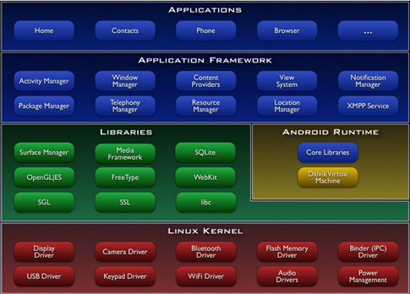
Motivation for Frameworks
Product
Variant 2
Product
Variant 3
Product
Variant 1
Product
Variant 4
Product-Line Architecture-based Application & Framework Software
Standard/COTS Hardware & Networks
Frameworks factors out many reusable general-purpose & domain-specific services from traditional DRE application responsibility
Essential for product-line architectures (PLAs)
Product-lines & frameworks offer many configuration opportunities
e.g., component distribution/deployment, OS, protocols, algorithms, etc.

Slide 22
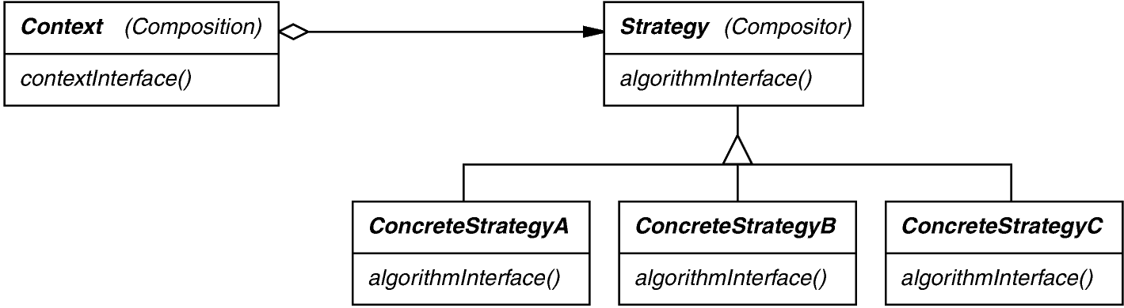
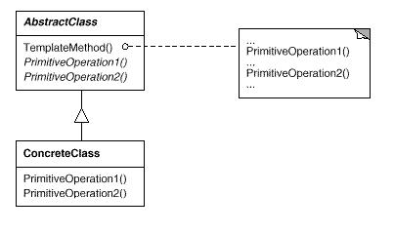
Categories of OO Frameworks
White-box frameworks are reused by subclassing, which usually requires understanding the implementation of the framework to some degree
Black-box framework is reused by parameterizing & assembling framework objects, thereby hiding their implementation from users
Each category of OO framework uses different sets of patterns, e.g.:
Black-box frameworks reply heavily on object composition patterns, such as Strategy & Decorator
White-box frameworks rely heavily on inheritance-based patterns, such as Template Method & State
Many frameworks fall in between white-box & black-box categories

Slide 23
Commonality & Variability Analysis in Frameworks
Framework characteristics are captured via Scope, Commonalities, & Variabilities (SCV) analysis
This process can be applied to identify commonalities & variabilities in a domain to guide development of a framework
Applying SCV to Android smartphones
Scope defines the domain & context of the framework
Component architecture, object-oriented application frameworks, & associated components, e.g., GPS, Network, & Display
Reusable Application Components
Reusable Architecture Framework

Slide 24
Applications
Phone
Email
Browser
Application Frameworks
Activity Manager
Window Manager
Location Manager
Linux Kernel
Networking I/O Framework
Device Driver Framework

Slide 25
Applying SCV to an Android Framework
Commonalities describe the attributes that are common across all members of the framework
Common object-oriented frameworks & set of component types
e.g., Activities, Services, Content Providers, & Display components
Common middleware infrastructure
e.g., Intents framework, Binder, etc.

Slide 26
Applying SCV to an Android Framework
Variabilities describe the attributes unique to the different members of the framework
Product-dependent component implementations, e.g., Motorola, HTC, Samsug
Product-dependent component connections
Product-dependent component assemblies (e.g., CDMA vs. GSM in different countries)
Different hardware, OS, & network/bus configurations
Notes:
Arvind, what is a variant specific component. Also I think there might be a need for a hyphen there. Also what is the purpose of the bullet “individual component impl”?
Arvind: Andy, it is to say that different variants can have different implementations. For example, One can have a GPS implementation while another can have a INS systems.
Timers can run at 40 Hz & others can run at 20 Hz
OK - andy

Slide 27
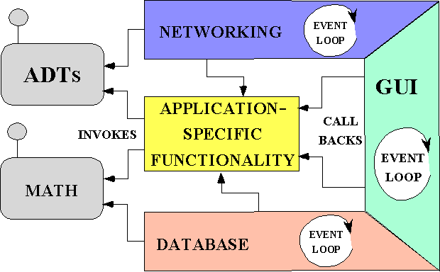
Comparing Reuse Techniques
APPLICATION-
SPECIFIC
FUNCTIONALITY
LOCAL
INVOCATIONS
Class Library (& STL) Architecture
Math
ADTs
IPC
A class is an implementation unit in an OO programming language, i.e., a reusable type that often implements patterns
Classes in class libraries are typically passive
Files
Strings
GUI
EVENT
LOOP
GLUE
CODE
Locks
ADTs
Reactor
NETWORKING
Framework Architecture
Strings
A framework is an integrated set of classes that collaborate to form a reusable architecture for a family of applications
Frameworks implement pattern languages
APPLICATION-SPECIFIC FUNCTIONALITY
INVOKES
CALL
BACKS
GUI
Files
Locks
DATABASE
Component & Service-Oriented Architecture
Naming
Events
A component is an encapsulation unit with one or more interfaces that provide clients with access to its services
Components can be deployed & configured via assemblies
Logging
Locking
Middleware Bus

Slide 28
Taxonomy of Reuse Techniques
Class
Libraries
Frameworks
Components
Micro-level
Meso-level
Macro-level
Stand-alone language entities
“Semi-complete” applications
Stand-alone composition entities
Domain-independent
Domain-specific
Domain-specific or Domain-independent
Borrow caller’s thread
Inversion of control
Borrow caller’s thread

Slide 29
Benefits of Frameworks
Design reuse
e.g., by guiding application developers through the steps necessary to ensure successful creation & deployment of software
AdminClient
PickingClient
Admin Controllers
Admin Views
Picking Controllers
Picking Views
Thin UI Clients
Proxy
Proxy
Broker
Broker
OS-Access Layer
Component Repository
Distribution
Infrastructure
Communication Services
Component Configurator
Broker
Broker
Scheduler/
ActivationList
Reactor
Service Request
ThreadPool
Logging Handler
*
Service Request
Service Request
Concurrency
Infrastructure
WarehouseRepHalfX

Slide 30
Benefits of Frameworks
Design reuse
e.g., by guiding application developers through the steps necessary to ensure successful creation & deployment of software
Implementation reuse
e.g., by amortizing software lifecycle costs & leveraging previous development & optimization efforts
package org.apache.tomcat.session;
import org.apache.tomcat.core.*;
import org.apache.tomcat.util.StringManager;
import java.io.*;
import java.net.*;
import java.util.*;
import javax.servlet.*;
import javax.servlet.http.*;
/**
* Core implementation of a server session
*
* @author James Duncan Davidson [duncan@eng.sun.com]
* @author James Todd [gonzo@eng.sun.com]
*/
public class ServerSession {
private StringManager sm =
StringManager.getManager("org.apache.tomcat.session");
private Hashtable values = new Hashtable();
private Hashtable appSessions = new Hashtable();
private String id;
private long creationTime = System.currentTimeMillis();;
private long thisAccessTime = creationTime;
private int inactiveInterval = -1;
ServerSession(String id) {
this.id = id;
}
public String getId() {
return id;
}
public long getCreationTime() {
return creationTime;
}
public ApplicationSession getApplicationSession(Context context,
boolean create) {
ApplicationSession appSession =
(ApplicationSession)appSessions.get(context);
if (appSession == null && create) {
// XXX
// sync to ensure valid?
appSession = new ApplicationSession(id, this, context);
appSessions.put(context, appSession);
}
// XXX
// make sure that we haven't gone over the end of our
// inactive interval -- if so, invalidate & create
// a new appSession
return appSession;
}
void removeApplicationSession(Context context) {
appSessions.remove(context);
}

Slide 31
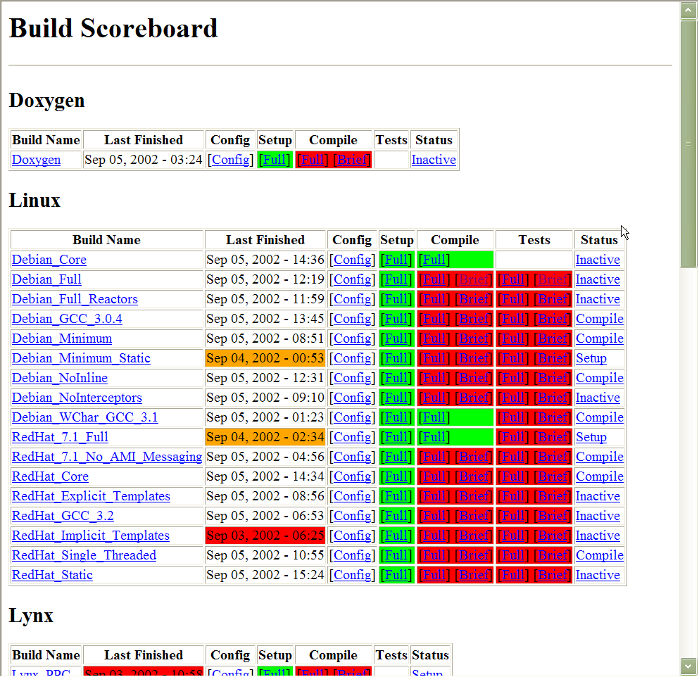
Benefits of Frameworks
Design reuse
e.g., by guiding application developers through the steps necessary to ensure successful creation & deployment of software
Implementation reuse
e.g., by amortizing software lifecycle costs & leveraging previous development & optimization efforts
Validation reuse
e.g., by amortizing the efforts of validating application- & platform-independent portions of software, thereby enhancing software reliability & scalability

Slide 32
Limitations of Frameworks
Frameworks are powerful, but can be hard to use effectively (& even harder to create) for many application developers
Commonality & variability analysis requires significant domain knowledge & OO design/implementation expertise
Significant time required to evaluate applicability & quality of a framework for a particular domain
Debugging is tricky due to inversion of control
V&V is tricky due to “late binding”
May incur performance degradations due to extra (unnecessary) levels of indirection
www.cs.wustl.edu/ ~schmidt/PDF/Queue-04.pdf
Many frameworks limitations can be addressed with knowledge of patterns!

Slide 33
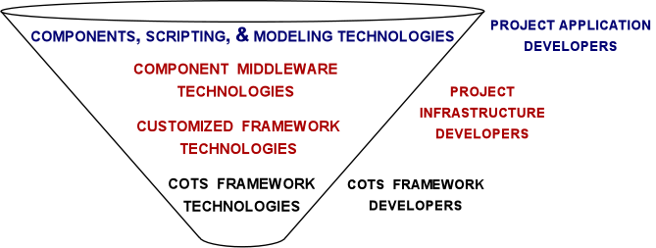
Using Frameworks Effectively
Observations
Since frameworks are powerful—but but hard to develop & use effectively by application developers—it’s often better to use & customize COTS frameworks than to develop in-house frameworks
Classes/components/services are easier for application developers to use, but aren’t as powerful or flexible as frameworks
Successful projects are therefore often organized using the “funnel” model

Slide 34
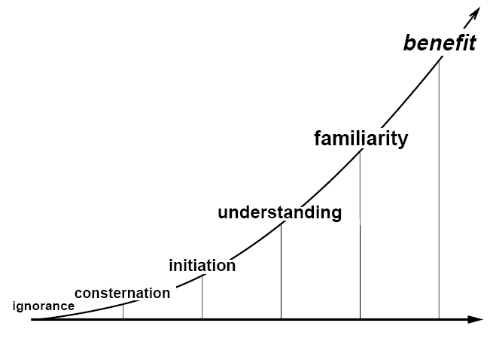
Stages of Pattern & Framework Awareness

Slide 35
Part II: Case Study: Expression Tree Application
Goals
Develop an object-oriented expression tree evaluator program using patterns & frameworks
Demonstrate commonality/variability analysis in the context of a concrete application example
Illustrate how OO frameworks can be combined with the generic programming features of C++ & STL
Compare/contrast OO & non-OO approaches
Binary
Nodes
Unary
Node
Leaf
Nodes

Slide 36
Overview of Expression Tree Application
Expression trees consist of nodes containing operators & operands
Operators have different precedence levels, different associativities, & different arities, e.g.:
Multiplication takes precedence over addition
The multiplication operator has two arguments, whereas unary minus operator has only one
Operands can be integers, doubles, variables, etc.
We'll just handle integers in this application
Application can be extended easily
Binary
Nodes
Unary
Node
Leaf
Nodes

Slide 37
Overview of Expression Tree Application
Trees may be “evaluated” via different traversal orders
e.g., in-order, post-order, pre-order, level-order
The evaluation step may perform various operations, e.g.:
Print the contents of the expression tree
Return the “value" of the expression tree
Generate code
Perform semantic analysis & optimization
etc.
Binary
Nodes
Unary
Node
Leaf
Nodes
See www.dre.vanderbilt.edu/~schmidt/qualcomm/tree-traversal.zip

Slide 38
Using the Expression Tree Application
By default, the expression tree application can run in “succinct mode,” e.g.:
% tree-traversal
> 1+4*3/2
7
> (8/4) * 3 + 1
7
^D
% tree-traversal -v
format [in-order]
expr [expression]
print [in-order|pre-order|post-order|level-order]
eval [post-order]
quit
> format in-order
> expr 1+4*3/2
> eval post-order
7
> quit
You can also run the expression tree application in “verbose mode,” e.g.:

Slide 39
How Not to Design an Expression Tree Application
A typical algorithmic-based solution for implementing expression trees uses a C struct/union to represent the main data structure
typedef struct Tree_Node {
enum { NUM, UNARY, BINARY } tag_;
short use_; /* reference count */
union {
char op_[2];
int num_;
} o;
#define num_ o.num_
#define op_ o.op_
union {
struct Tree_Node *unary_;
struct { struct Tree_Node *l_, *r_;} binary_;
} c;
#define unary_ c.unary_
#define binary_ c.binary_
} Tree_Node;

Slide 40
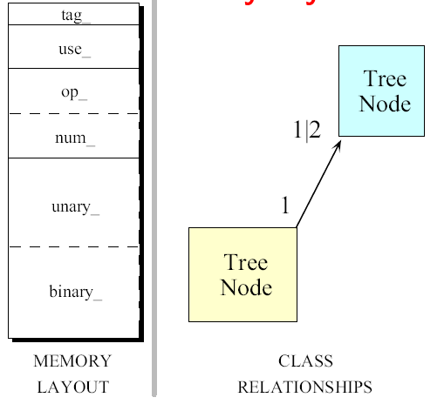
How Not to Design an Expression Tree Application
Here’s the memory layout & class diagram for a struct Tree_Node:

Slide 41
How Not to Design an Expression Tree Application
A typical algorithmic implementation uses a switch statement & a recursive function to build & evaluate a tree, e.g.:
void print_tree (Tree_Node *root) {
switch (root->tag_)
case NUM: printf (“%d”, root->num_); break;
case UNARY:
printf ("(%s”, root->op_[0]);
print_tree (root->unary_);
printf (")"); break;
case BINARY:
printf ("(");
print_tree (root->binary_.l_); // Recursive call
printf (“%s”, root->op_[0]);
print_tree (root->binary_.r_); // Recursive call
printf (")"); break;
default:
printf ("error, unknown type ");
}

Slide 42
Limitations with the Algorithmic Approach
Little or no use of encapsulation: implementation details available to clients
Incomplete modeling of the application domain, which results in
Tight coupling between nodes/edges in union representation
Complexity being in algorithms rather than the data structures
e.g., switch statements are used to select between various types of nodes in the expression trees
Data structures are “passive” functions that do their work explicitly
The program organization makes it hard to extend
e.g., small changes will ripple through the entire design & implementation
Easy to make mistakes switching on type tags
Wastes space by making worst-case assumptions wrt structs & unions

Slide 43
An OO Alternative Using Patterns & Frameworks
Start with OO modeling of the “expression tree” application domain
Conduct commonality/variability analysis (CVA) to determine stable interfaces & points of variability
Apply patterns to guide design/implementation of framework
Integrate w/C++ STL algorithms/containers when appropriate
Binary
Nodes
Model a tree as a collection of nodes
Nodes are represented in an inheritance hierarchy that captures the particular properties of each node
e.g., precedence levels, different associativities, & different arities
Application-dependent steps
Unary
Node
Leaf
Nodes
Application-independent steps

Slide 44
Design Problems & Pattern-Oriented Solutions
Design Problem | Pattern(s)
Expression tree structure | Composite
Encapsulating variability & simplifying memory management | Bridge
Tree printing & evaluation | Iterator & Visitor
Consolidating user operations | Command
Ensuring correct protocol for commands | State
Consolidating creation of Variabilities | Abstract Factory & Factory Method
Parsing expressions & creating expression tree | Interpreter & Builder
Binary
Nodes
Unary
Node
Leaf
Nodes

Slide 45
Design Problems & Pattern-Oriented Solutions
Design Problem | Pattern(s)
Driving the application event flow | Reactor
Supporting multiple operation modes | Template Method & Strategy
Centralizing global objects effectively | Singleton
Implementing STL iterator semantics | Prototype
Eliminating loops via the STL std::for_each() algorithm | Adapter
Provide no-op commands | Null Object
Binary
Nodes
Unary
Node
Leaf
Nodes
None of these patterns are restricted to expression tree applications…

Slide 46
Managing Global Objects Effectively
Goals:
Centralize access to objects that should be visible globally, e.g.:
command-line options that parameterize the behavior of the program
The object (Reactor) that drives the main event loop
Constraints/forces:
Only need one instance of the command-line options & Reactor
Global variables are problematic in C++
Verbose mode
% tree-traversal -v
format [in-order]
expr [expression]
print [in-order|pre-order|post-order|level-order]
eval [post-order]
quit
> format in-order
> expr 1+4*3/2
> eval post-order
7
> quit
% tree-traversal
> 1+4*3/2
7
Succinct mode

Slide 47
Solution: Centralize Access to Global Instances
Rather than using global variables, create a central access point to global instances, e.g.:
int main (int argc, char *argv[])
{
// Parse the command-line options.
if (!Options::instance ()->parse_args (argc, argv))
return 0;
// Dynamically allocate the appropriate event handler
// based on the command-line options.
Expression_Tree_Event_Handler *tree_event_handler =
Expression_Tree_Event_Handler::make_handler
(Options::instance ()->verbose ());
// Register event handler with the reactor.
Reactor::instance ()->register_input_handler
(tree_event_handler);
// ...

Slide 48
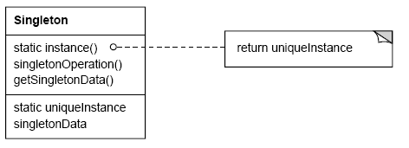
Singleton object creational
Intent
ensure a class only ever has one instance & provide a global point of access
Applicability
when there must be exactly one instance of a class & it must be accessible from a well-known access point
when the sole instance should be extensible by subclassing & clients should be able to use an extended instance without modifying their code
Structure
If (uniqueInstance == 0)
uniqueInstance = new Singleton;
return uniqueInstance;

Slide 49
Singleton object creational
Consequences
reduces namespace pollution
makes it easy to change your mind & allow more than one instance
allow extension by subclassing
same drawbacks of a global if misused
implementation may be less efficient than a global
concurrency/cache pitfalls & communication overhead
Implementation
static instance operation
registering the singleton instance
deleting singletons
Known Uses
Unidraw's Unidraw object
Smalltalk-80 ChangeSet, the set of changes to code
InterViews Session object
See Also
Double-Checked Locking Optimization pattern from POSA2
“To Kill a Singleton” www.research.ibm.com/ designpatterns/pubs/ ph-jun96.txt

Slide 50
Overview of Tree Structure & Creation Patterns
Purpose: Parse the input & create the key internal data structure for the expression tree
Interpreter
Expression_Tree
Expression_Tree_
Context
Interpreter_Context
<< use >>
Interpreter
Component_Node
Symbol
<< build >>
Leaf_Node
Composite_
Binary_Node
Composite_
Unary_Node
Number
Operator
Unary_Operator
<< build >>
Composite_
Add_Node
Composite_
Substract_Node
Composite_
Negate_Node
Add
Substract
Negate
Composite_
Multiply_Node
Composite_
Divide_Node
Multiply
Divide
<< build >>
Composite
Builder
Composite
Patterns (& pattern combos) help focus on “forests” rather than (just) “trees”

Slide 51
Expression Tree Structure
Goals:
Support “physical” structure of expression tree
e.g., binary/unary operators & operators
Provide “hook” for enabling arbitrary operations on tree nodes
Via Visitor pattern (described later)
Constraints/forces:
Treat operators & operands uniformly
No distinction between one vs. many to avoid/minimize special cases
Unary
Node
Leaf
Nodes

Slide 52
Solution: Recursive Structure
Model a tree as a recursive collection of nodes
Nodes are represented in an inheritance hierarchy that captures the particular properties of each node
e.g., precedence levels, different associativities, & different arities
Binary nodes recursively contain two other child nodes; unary nodes recursively contain one other child node
Binary
Nodes
Unary
Node
Leaf
Nodes

Slide 53
Component_Node
Abstract base class for composable expression tree node objects
Interface:
virtual | ~Component_Node (void)=0
virtual int | item (void) const
virtual Component_Node * | left (void) const
virtual Component_Node * | right (void) const
virtual void | accept (Visitor &visitor) const
Subclasses:
Leaf_Node, Composite_Unary_Node, Composite_Binary_Node, etc.
Commonality: base class interface is used by all nodes in an expression tree
Variability: each subclass defines state & method implementations that are specific for the various types of nodes

Slide 54
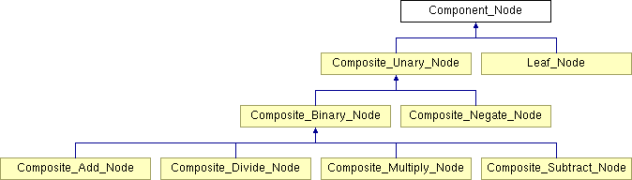
Component_Node Hierarchy
Note the inherent recursion in this hierarchy
i.e., a Composite_Binary_Node is a Component_Node & a Composite_Binary_Node also has Component_Nodes!

Slide 55
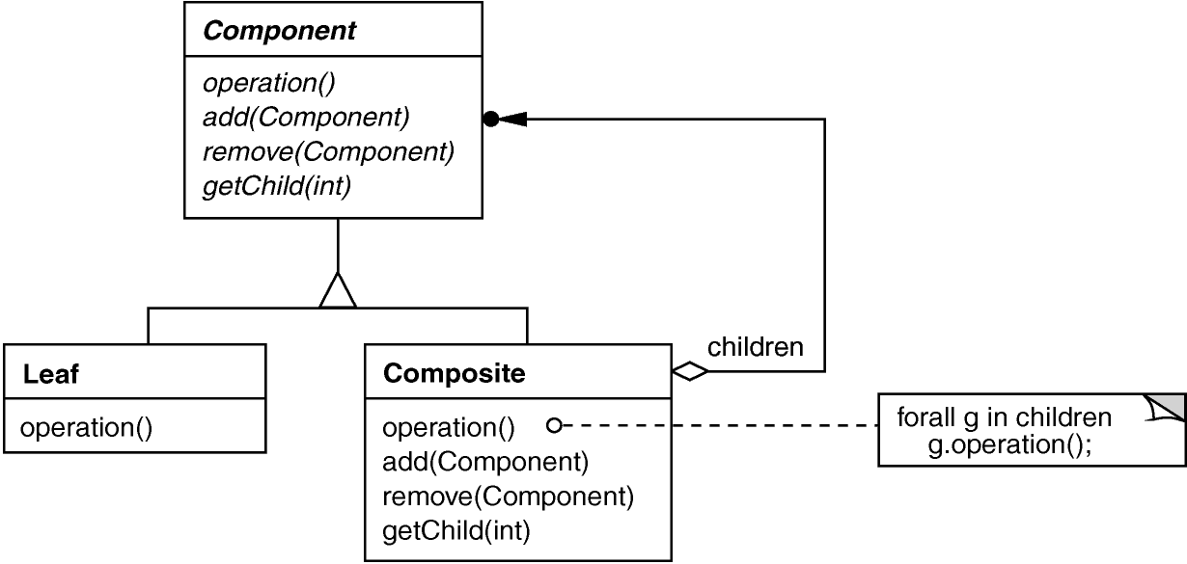
Composite object structural
Intent
treat individual objects & multiple, recursively-composed objects uniformly
Applicability
objects must be composed recursively,
and no distinction between individual & composed elements,
and objects in structure can be treated uniformly
e.g., Component_Node
Structure
e.g., Leaf_Node
e.g., Composite_Unary_Node, Composite_Binary_Node, etc.

Slide 56
Composite object structural
Consequences
uniformity: treat components the same regardless of complexity
extensibility: new Component subclasses work wherever old ones do
overhead: might need prohibitive numbers of objects
Awkward designs: may need to treat leaves as lobotomized composites in some cases
Implementation
do Components know their parents?
uniform interface for both leaves & composites?
don’t allocate storage for children in Component base class
responsibility for deleting children
Known Uses
ET++ Vobjects
InterViews Glyphs, Styles
Unidraw Components, MacroCommands
Directory structures on UNIX & Windows
Naming Contexts in CORBA
MIME types in SOAP

Slide 57
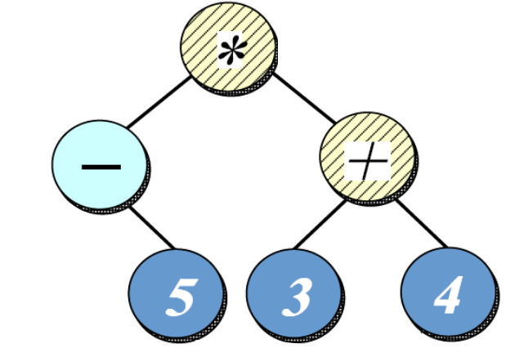
Parsing Expressions & Creating Expression Tree
Goals:
Simplify & centralize the creation of all nodes in the composite expression tree
Extensible for future types of expression orderings & optimizations
Constraints/forces:
Don’t recode existing clients when changes occur
Add new expressions without recompiling existing code
“in-order” expression = -5*(3+4)
“pre-order” expression = *-5+34
“post-order” expression = 5-34+*
“level-order” expression = *-+534

Slide 58
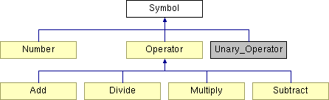
Solution: Build Parse Tree Using Interpreter
Use an interpreter to create a parse tree corresponding to input expression
This parse tree is then traversed to build the appropriate type of nodes in the corresponding expression tree
We create the entire parse tree to enable future optimizations
In_Order_ Uninitialized_State
make_tree()
Interpreter_Context
Interpreter
This class uses the State & Factory Method patterns (described later)

Slide 59
Interpreter
Parses expressions into parse tree & generate corresponding expression tree
Interface:
 | Interpreter (void)
virtual | ~Interpreter (void)
Expression _Tree | interpret (Interpreter_Context &context, const std::string &input)
uses
 | Interpreter_Context (void)
 | ~Interpreter_Context (void)
int | get (std::string variable)
void | set (std::string variable, int value)
void | print (void)
void | reset (void)
creates
 | Symbol (Symbol *left, Symbol *right)
virtual | ~Symbol (void)
virtual int | precedence (void)=0
virtual Component_Node * | build (void)=0
Commonality: Provides a common interface for parsing expression input & building parse trees & expression trees
Variability: The structure of the parse trees & expression trees can vary depending on the format & contents of the expression input

Slide 60
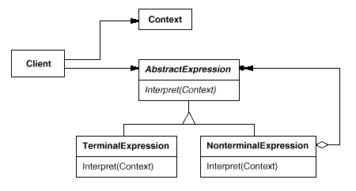
Interpreter class behavioral
Intent
Given a language, define a representation for its grammar along with an interpreter that uses the representation to interpret sentences in the language
Applicability
When the grammar is simple & relatively stable
Efficiency is not a critical concern
Structure
e.g., Symbol
e.g., Operator, Add, Subtract, Divide, Multiply, etc.
e.g., Number

Slide 61
Interpreter class behavioral
Consequences
Simple grammars are easy to change & extend, e.g., all rules represented by distinct classes in an orderly manner
Adding another rule adds another class
Complex grammars are hard to implement & maintain, e.g., more interdependent rules yield more interdependent classes
Implementation
Express the language rules, one per class
Alternations, repetitions, or sequences expressed as nonterminal expresssions
Literal translations expressed as terminal expressions
Create interpret method to lead the context through the interpretation classes
Known Uses
Text editors &Web browsers use Interpreter to lay out documents & check spelling
For example, an equation in TeX is represented as a tree where internal nodes are operators, e.g. square root, & leaves are variables

Slide 62
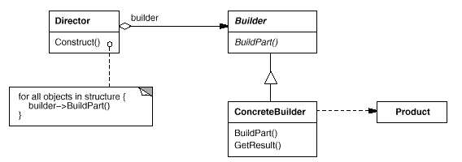
Builder object creational
Intent
Separate the construction of a complex object from its representation so that the same construction process can create different representations
Applicability
Need to isolate knowledge of the creation of a complex object from its parts
Need to allow different implementations/interfaces of an object's parts
Structure
e.g., Symbol
e.g., Number, Operator, Add, Subtract, etc.
e.g., Interpreter
e.g., Leaf_Node, Composite_Add_Node, etc.

Slide 63
Builder object creational
Consequences
Can vary a product's internal representation
Isolates code for construction & representation
Finer control over the construction process
May involve a lot of classes
Implementation
The Builder pattern is basically a Factory pattern with a mission
A Builder pattern implementation exposes itself as a factory, but goes beyond the factory implementation in that various implementations are wired together
Known Uses
ACE Service Configurator framework

Slide 64
Summary of Tree Structure & Creation Patterns
Interpreter
Expression_Tree
Expression_Tree_
Context
Interpreter_Context
<< use >>
Interpreter
Component_Node
Symbol
<< build >>
Leaf_Node
Composite_
Binary_Node
Composite_
Unary_Node
Number
Operator
Unary_Operator
<< build >>
Composite_
Add_Node
Composite_
Substract_Node
Composite_
Negate_Node
Add
Substract
Negate
Composite_
Multiply_Node
Composite_
Divide_Node
Multiply
Divide
<< build >>
Composite
Builder
Composite
There are many classes, but only a handful of patterns involved in this design

Slide 65
Overview of Tree Traversal Patterns
Purpose: Traverse the expression tree & perform desired operations
Visitor
Expression_Tree
Component_Node
<< accept >>
Visitor
Iterator
<< create >>
Expression_Tree_
Iterator
Expression_Tree_
Iterator_Impl
Evaluation_Visitor
Print_Visitor
LQueue
Level_Order_Expression_
Tree_Iterator_Impl
Bridge
In_Order_Expression_
Tree_Iterator_Impl
std::stack
Post_Order_Expression_
Tree_Iterator_Impl
Pre_Order_Expression_
Tree_Iterator_Impl
Patterns extensibly decouple structure of expression tree from operations on it

Slide 66
Encapsulating Variability & Simplifying Memory Managment
Goals
Hide many sources of variability in expression tree construction & use
Simplify C++ memory management, i.e., minimize use of new/delete in application code
Constraints/forces:
Must account for the fact that STL algorithms & iterators have “value semantics”
Must ensure that exceptions don’t cause memory leaks
for (Expression_Tree::iterator iter = tree.begin ();
iter != tree.end ();
++iter)
(*iter).accept (print_visitor);

Slide 67
Solution: Decouple Interface & Implementation(s)
Expression_Tree
Create a public interface class (Expression_Tree) used by clients & a private implementation hierarchy (rooted at Component_Node) that encapsulates variability
The public interface class can perform reference counting of implementation object(s) to automate memory management
An Abstract Factory can produce the right implementation (as seen later)

Slide 68
Expression_Tree
Interface for Composite pattern used to contain all nodes in expression tree
Interface:
 | Expression_Tree (void)
 | Expression_Tree (Component_Node *root)
 | Expression_Tree (const Expression_Tree &t)
void | operator= (const Expression_Tree &t)
 | ~Expression_Tree (void)
Component_Node * | get_root (void)
bool | is_null (void) const
const int | item (void) const
Expression_Tree | left (void)
Expression_Tree | right (void)
iterator | begin (const std::string &traversal_order)
iterator | end (const std::string &traversal_order)
const_iterator | begin (const std::string &traversal_order) const
const_iterator | end (const std::string &traversal_order) const
Commonality: Provides a common interface for expression tree operations
Variability: The contents of the expression tree nodes can vary depending on the expression

Slide 69
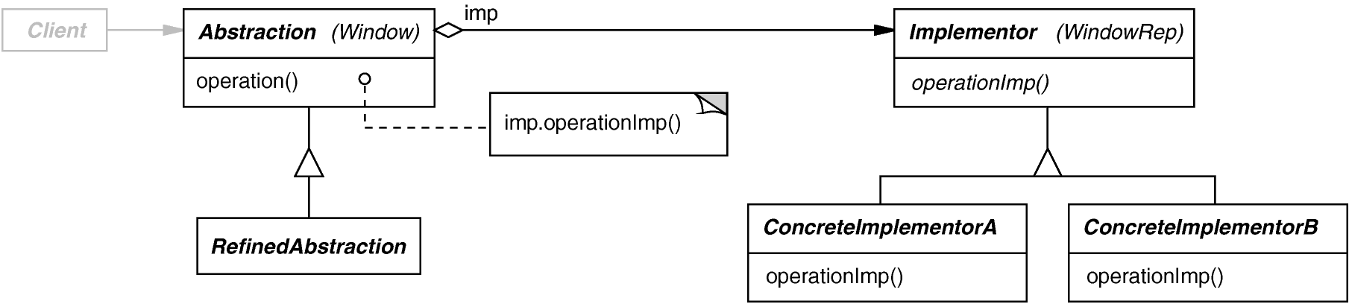
Bridge object structural
Intent
Separate a (logical) abstraction interface from its (physical) implementation(s)
Applicability
When interface & implementation should vary independently
Require a uniform interface to interchangeable class hierarchies
Structure

Slide 70
Bridge object structural
Consequences
abstraction interface & implementation are independent
implementations can vary dynamically
Can be used transparently with STL algorithms & containers
one-size-fits-all Abstraction & Implementor interfaces
Implementation
sharing Implementors & reference counting
See reusable Refcounter template class (based on STL/boost shared_pointer)
creating the right Implementor (often use factories)
Known Uses
ET++ Window/WindowPort
libg++ Set/{LinkedList, HashTable}
AWT Component/ComponentPeer

Slide 71
Tree Printing & Evaluation
Goals:
create a framework for performing algorithms that affect nodes in a tree
Constraints/forces:
support multiple algorithms that can act on the expression tree
don’t tightly couple algorithms with expression tree structure
e.g., don’t have “print” & “evaluate” methods in the node classes
Algo 2: Evaluate the “yield” of the nodes in the tree
Algo 1: Print all the values of the nodes in the tree
Binary
Nodes
Unary
Node
Leaf
Nodes

Slide 72
Solution: Encapsulate Traversal
Iterator
encapsulates a traversal algorithm without exposing representation details to callers
e.g.,
“in-order iterator” = -5*(3+4)
“pre-order iterator” = *-5+34
“post-order iterator” = 5-34+*
“level-order iterator” = *-+534
Unary
Node
Leaf
Nodes
Expression_Tree_Iterator
Expression_Tree_Iterator_Impl
In_Order_Expression_Tree_Iterator_Impl
Post_Order_Expression_Tree_Iterator_Impl
Level_Order_Expression_Tree_Iterator_Impl
Pre_Order_Expression_Tree_Iterator_Impl
Note use of the Bridge pattern to encapsulate variability

Slide 73
Expression_Tree_Iterator
Interface for Iterator pattern that traverses all nodes in tree expression
Interface:
 | Expression_Tree_Iterator (const Expression_Tree_Iterator &)
 | Expression_Tree_Iterator (Expression_Tree_Iterator_Impl *)
Expression_Tree | operator * (void)
const Expression_Tree | operator * (void) const
Expression_Tree_Iterator & | operator++ (void)
Expression_Tree_Iterator | operator++ (int)
bool | operator== (const Expression_Tree_Iterator &rhs)
bool | operator!= (const Expression_Tree_Iterator &rhs)
Commonality: Provides a common interface for expression tree iterators that conforms to the standard STL iterator interface
Variability: Can be configured with specific expression tree iterator algorithms via the Bridge & Abstract Factory patterns
See Expression_Tree_State.cpp for example usage

Slide 74
Expression_Tree_Iterator_Impl
Implementation of the Iterator pattern that is used to define the various iterations algorithms that can be performed to traverse the expression tree
Interface:
 | Expression_Tree_Iterator_Impl (const Expression_Tree &tree)
virtual | ~Expression_Tree_Iterator_Impl (void)
virtual Expression_Tree | operator * (void) =0
virtual const Expression_Tree | operator * (void) const =0
virtual void | operator++ (void)=0
virtual bool | operator== (const Expression_Tree_Iterator_Impl &rhs) const =0
virtual bool | operator!= (const Expression_Tree_Iterator_Impl &rhs) const =0
virtual Expression_Tree_Iterator_Impl * | clone (void)=0
Commonality: Provides a common interface for implementing expression tree iterators that conforms to the standard STL iterator interface
Variability: Can be subclasses to define various algorithms for accessing nodes in the expression trees in a particular traversal order

Slide 75
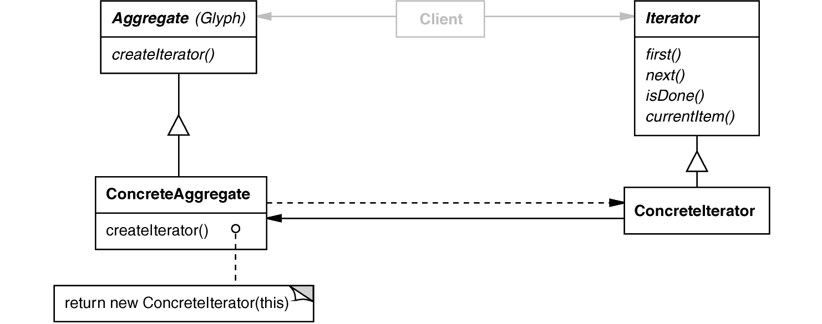
Iterator object behavioral
Intent
access elements of a aggregate (container) without exposing its representation
Applicability
require multiple traversal algorithms over an aggregate
require a uniform traversal interface over different aggregates
when aggregate classes & traversal algorithm must vary independently
Structure

Slide 76
Comparing STL Iterators with GoF Iterators
STL iterators have “value-semantics”, e.g.:
for (Expression_Tree::iterator iter = tree.begin (”Level Order”);
iter != tree.end (”Level Order”);
++iter)
(*iter).accept (print_visitor);
In contrast, “GoF iterators have “pointer semantics”, e.g.:
Iterator *iter;
for (iter = tree.createIterator (”Level Order”);
iter->done () == false;
iter->advance ())
(iter->currentElement ())->accept (print_visitor);
delete iter;
The Bridge pattern simplifies use of STL iterators in expression tree application

Slide 77
Iterator object behavioral
Consequences
flexibility: aggregate & traversal are independent
multiple iterators & multiple traversal algorithms
additional communication overhead between iterator & aggregate
This is particularly problematic for iterators in concurrent or distributed systems
Implementation
internal versus external iterators
violating the object structure’s encapsulation
robust iterators
synchronization overhead in multi-threaded programs
batching in distributed & concurrent programs
Known Uses
C++ STL iterators
C++11 “range-based for loops”
JDK Enumeration, Iterator
Unidraw Iterator

Slide 78
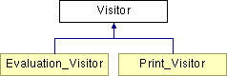
Visitor
Defines action(s) at each step of traversal & avoids wiring action(s) in nodes
Iterator calls nodes’s accept(Visitor) at each node, e.g.:
void Leaf_Node::accept (Visitor &v) { v.visit (*this); }
accept() calls back on visitor using “static polymorphism”
Interface:
virtual void | visit (const Leaf_Node &node)=0
virtual void | visit (const Composite_Negate_Node &node)=0
virtual void | visit (const Composite_Add_Node &node)=0
virtual void | visit (const Composite_Subtract_Node &node)=0
virtual void | visit (const Composite_Divide_Node &node)=0
virtual void | visit (const Composite_Multiply_Node &node)=0
Commonality: Provides a common accept()method for all expression tree nodes & common visit()method for all visitor subclasses
Variability: Can be subclassed to define specific behaviors for the visitors & nodes

Slide 79
Print_Visitor
Prints character code or value for each node
Can be combined with any traversal algorithm, e.g.:
class Print_Visitor : public Visitor {
public:
virtual void visit (const Leaf_Node &);
virtual void visit (const Add_Node &);
virtual void visit (const Divide_Node &);
// etc. for all relevant Component_Node subclasses
};
Print_Visitor print_visitor;
for (Expression_Tree::iterator iter =
tree.begin (”post-order”);
iter != tree.end (”post-order”);
++iter)
(*iter).accept (print_visitor); // calls visit (*this);
See Expression_Tree_State.cpp for example usage

Slide 80
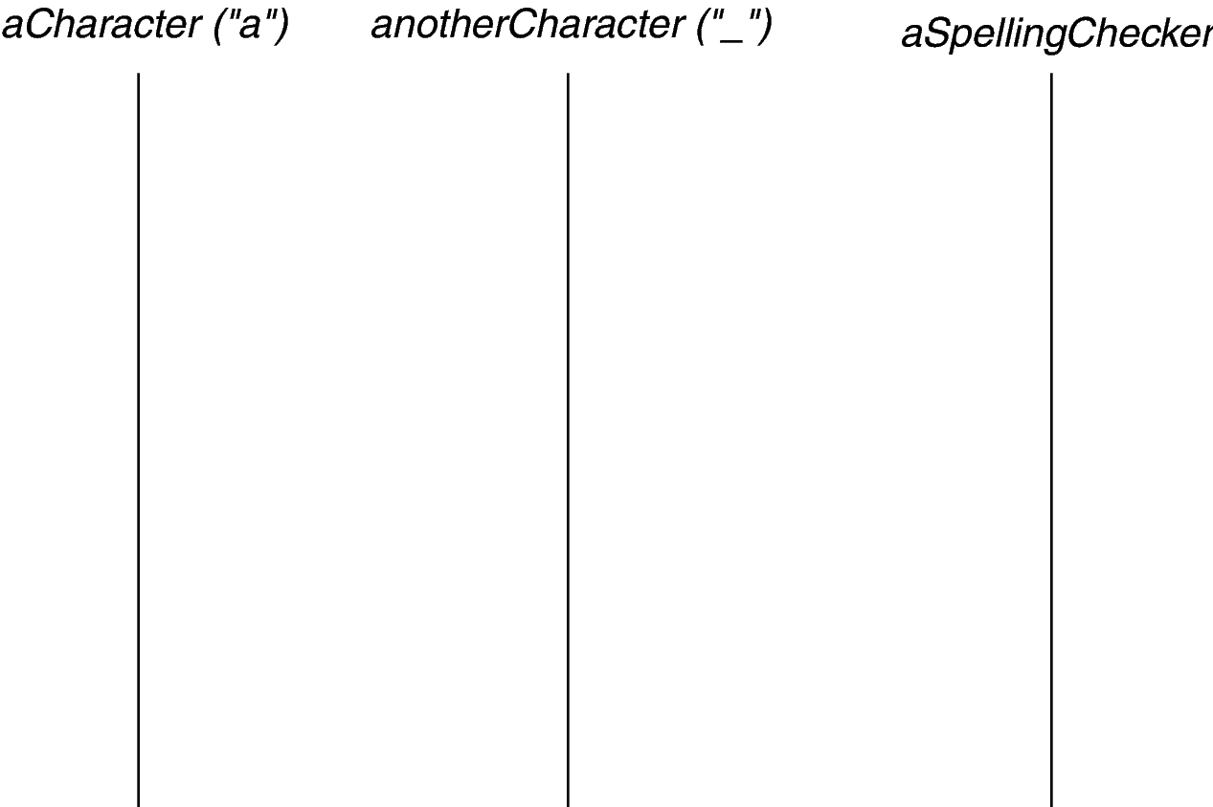
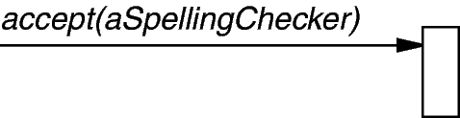
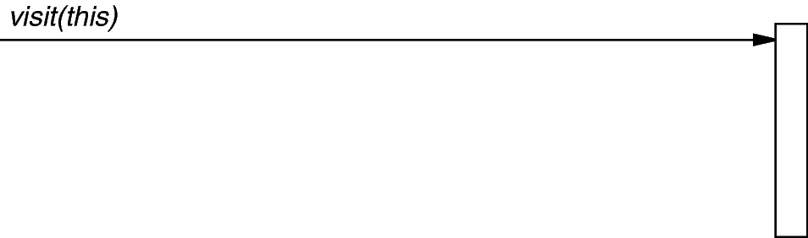
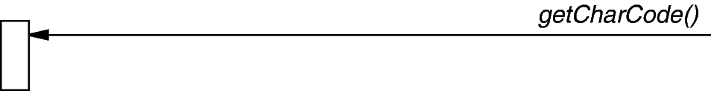
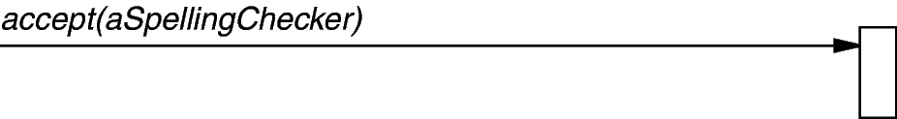
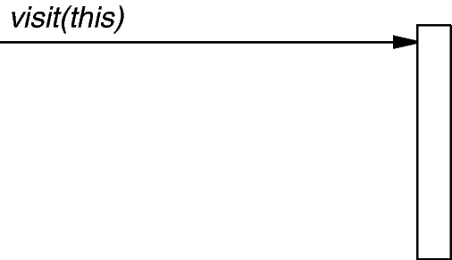

Print_Visitor Interaction Diagram
The iterator controls the order in which accept()is called on each node in the composition
accept()then “visits” the node to perform the desired print action
Leaf_Node (5)
Composite_Negate_Node
print_visitor
accept(print_visitor)
cout<< node.item ();
accept(print_visitor)
cout<< ‘-’

Slide 81
Evaluation_Visitor
This class serves as a visitor for evaluating nodes in an expression tree that is being traversed using a post-order iterator
e.g., 5-34+*
It uses a stack to keep track of the post-order expression tree value that has been processed thus far during the iteration traversal, e.g.:
S = [5] push(node.item())
S = [-5] push(-pop())
S = [-5, 3] push(node.item())
S = [-5, 3, 4] push(node.item())
S = [-5, 7] push(pop()+pop())
S = [-35] push(pop()*pop())
class Evaluation_Visitor :
public Visitor { /* ... */ };
Unary
Node
Leaf
Nodes

Slide 82
Evaluation_Visitor Interaction Diagram
The iterator controls the order in which accept()is called on each node in the composition
accept()then “visits” the node to perform the desired evaluation action
Leaf_Node (5)
Composite_Negate_Node
eval_visitor
accept(eval_visitor)
stack_.push(node.item ());
accept(eval_visitor)
stack_.push(-stack_.pop());

Slide 83



Visitor object behavioral
Intent
Centralize operations on an object structure so that they can vary independently but still behave polymorphically
Applicability
when classes define many unrelated operations
class relationships of objects in the structure rarely change, but the operations on them change often
algorithms keep state that’s updated during traversal
Structure
Note “static polymorphism” based on method overloading by type

Slide 84
Visitor object behavioral
Consequences
flexibility: visitor algorithm(s) & object structure are independent
localized functionality in the visitor subclass instance
circular dependency between Visitor & Element interfaces
Visitor brittle to new ConcreteElement classes
Implementation
double dispatch
general interface to elements of object structure
Known Uses
ProgramNodeEnumerator in Smalltalk-80 compiler
IRIS Inventor scene rendering
TAO IDL compiler to handle different backends

Slide 85
Summary of Tree Traversal Patterns
Visitor
Expression_Tree
Component_Node
<< accept >>
Visitor
Iterator
<< create >>
Expression_Tree_
Iterator
Expression_Tree_
Iterator_Impl
Evaluation_Visitor
Print_Visitor
LQueue
Level_Order_Expression_
Tree_Iterator_Impl
Bridge
In_Order_Expression_
Tree_Iterator_Impl
std::stack
Post_Order_Expression_
Tree_Iterator_Impl
Pre_Order_Expression_
Tree_Iterator_Impl
Patterns allow adding new operations extensibly without affecting structure

Slide 86
Overview of Command & Factory Patterns
Purpose: Define operations that can be performed on an expression tree
AbstractFactory
Expression_Tree_
Event_Handler
Expression_Tree_
Command_Factory
Expression_Tree_Command_
Factory_Impl
<< create >>
Concrete_Expression_Tree_
Command_Factory_Impl
Expression_Tree_
Context
*
Expression_Tree_
Command
Expression_Tree_
Command_Impl
Command
1
Macro_Command
Print_Command
Set_Command
Quit_Command
Null_Command
Format_Command
Expr_Command
Eval_Command
These patterns decouple creation from use & provide a uniform command API

Slide 87
Consolidating User Operations
Goals:
support execution of user operations
support macro commands
support undo/redo
Constraints/forces:
scattered operation implementations
Consistent memory management
% tree-traversal -v
format [in-order]
expr [expression]
print [in-order|pre-order|post-order|level-order]
eval [post-order]
quit
> format in-order
> expr 1+2*3/2
> print in-order
1+2*3/2
> print pre-order
+1/*232
> eval post-order
4
> quit

Slide 88
Solution: Encapsulate Each Request w/Command
A Command encapsulates
Command may
implement the operations itself, or
forward them to other object(s)
an operation (execute())
an inverse operation (unexecute())
a operation for testing reversibility (boolean reversible())
state for (un)doing the operation
Expression_Tree_Command
Expression_Tree_Command_Impl
Format_Command
Print_Command
Eval_Command
Quit_Command
Expr_Command
Macro_Command
Note use of Bridge pattern to encapsulate variability & simplify memory management

Slide 89
Expression_Tree_Command
Interface for Command pattern used to define a command that performs an operation on the expression tree when executed
Interface:
 | Expression_Tree_Command (Expression_Tree_Command_Impl *=0)
 | Expression_Tree_Command (const Expression_Tree_Command &)
Expression_Tree_Command & | operator= (const Expression_Tree_Command &)
 | ~Expression_Tree_Command (void)
bool | execute (void)
bool | unexecute (void)
Commonality: Provides a common interface for expression tree commands
Variability: The implementations of the expression tree commands can vary depending on the operations requested by user input

Slide 90
List of Commands = Execution History
Undo:
unexecute()
unexecute()
Redo:
unexecute()
execute()
cmd
cmd
cmd
cmd
past
future
past
future

Slide 91




Command object behavioral
Intent
Encapsulate the request for a service
Applicability
to parameterize objects with an action to perform
to specify, queue, & execute requests at different times
for multilevel undo/redo
Structure

Slide 92
Command object behavioral
Consequences
abstracts executor of a service
supports arbitrary-level undo-redo
composition yields macro-commands
might result in lots of trivial command subclasses
excessive memory may be needed to support undo/redo operations
Implementation
copying a command before putting it on a history list
handling hysteresis
supporting transactions
Known Uses
InterViews Actions
MacApp, Unidraw Commands
JDK’s UndoableEdit, AccessibleAction
Emacs
Microsoft Office tools

Slide 93
Consolidating Creation of Variabilities
Goals:
Simplify & centralize the creation of all variabilities in the expression tree application to ensure semantic compatibility
Be extensible for future variabilities
Constraints/forces:
Don’t recode existing clients
Add new variabilities without recompiling
Expression_Tree_Command
Expression_Tree_Command_Impl
Format_Command
Print_Command
Eval_Command
Quit_Command
Expr_Command
Macro_Command
Expression_Tree_Iterator
Expression_Tree_Iterator_Impl
In_Order_Expression_Tree_Iterator_Impl
Post_Order_Expression_Tree_Iterator_Impl
Level_Order_Expression_Tree_Iterator_Impl
Pre_Order_Expression_Tree_Iterator_Impl

Slide 94
Solution: Abstract Object Creation
Instead of
Expression_Tree_Command command
= new Print_Command ();
Use
Expression_Tree_Command command
= command_factory.make_command (”print”);
where command_factory is an instance of Expression_Tree_Command_Factory or anything else that makes sense wrt our goals
Expression_Tree_Command_Factory
Expression_Tree_Command_Factory_Impl
Concrete_Expression_Tree_Command_Factory_Impl

Slide 95
Expression_Tree_Command_Factory
Interface for Abstract Factory pattern used to create appropriate command based on string supplied by caller
 | Expression_Tree_Command_Factory (Expression_Tree_Context &tree_context)
 | Expression_Tree_Command_Factory (const Expression_Tree_Command_Factory &f)
void | operator= (const Expression_Tree_Command_Factory &f)
 | ~Expression_Tree_Command_Factory (void)
Expression_Tree_Command | make_command (const std::string &s)
Expression_Tree_Command | make_format_command (const std::string &)
Expression_Tree_Command | make_expr_command (const std::string &)
Expression_Tree_Command | make_print_command (const std::string &)
Expression_Tree_Command | make_eval_command (const std::string &)
Expression_Tree_Command | make_quit_command (const std::string &)
Expression_Tree_Command | make_macro_command (const std::string &)
Interface:
Commonality: Provides a common interface to create commands
Variability: The implementations of the expression tree command factory methods can vary depending on the requested commands

Slide 96
Factory Structure
Expression_Tree_Command_Factory
Expression_Tree_Command
Expression_Tree_Command_Factory_Impl
Expression_Tree_Command_Impl
Concrete_Expression_Tree_Command_Factory_Impl
make_format_command()
make_expr_command()
make_print_command()
make_eval_command()
make_macro_command()
make_quit_command()
Format_Command
Expr_Command
Print_Command
Eval_Command
Macro_Command
Quit_Command
Note use of Bridge pattern to encapsulate variability & simplify memory management

Slide 97

Factory Method class creational
Intent
Provide an interface for creating an object, but leave choice of object’s concrete type to a subclass
Applicability
when a class cannot anticipate the objects it must create or a class wants its subclasses to specify the objects it creates
Structure

Slide 98
Factory Method class creational
Consequences
+By avoiding to specify the class name of the concrete class &the details of its creation the client code has become more flexible
+The client is only dependent on the interface
- Construction of objects requires one additional class in some cases
Implementation
There are two choices here
The creator class is abstract & does not implement creation methods (then it must be subclassed)
The creator class is concrete & provides a default implementation (then it can be subclassed)
Should a factory method be able to create different variants? If so the method must be equipped with a parameter
Known Uses
InterViews Kits
ET++ WindowSystem
AWT Toolkit
The ACE ORB (TAO)
BREW
UNIX open() syscall

Slide 99



Abstract Factory object creational
Intent
create families of related objects without specifying subclass names
Applicability
when clients cannot anticipate groups of classes to instantiate
Structure
See Uninitialized_State_Factory & Expression_Tree_Event_Handler for Factory pattern variants

Slide 100
Abstract Factory object creational
Consequences
flexibility: removes type (i.e., subclass) dependencies from clients
abstraction & semantic checking: hides product’s composition
hard to extend factory interface to create new products
Implementation
parameterization as a way of controlling interface size
configuration with Prototypes, i.e., determines who creates the factories
abstract factories are essentially groups of factory methods
Known Uses
InterViews Kits
ET++ WindowSystem
AWT Toolkit
The ACE ORB (TAO)

Slide 101
Summary of Command & Factory Patterns
AbstractFactory
Expression_Tree_
Event_Handler
Expression_Tree_
Command_Factory
Expression_Tree_Command_
Factory_Impl
<< create >>
Concrete_Expression_Tree_
Command_Factory_Impl
Expression_Tree_
Context
*
Expression_Tree_
Command
Expression_Tree_
Command_Impl
Command
1
Macro_Command
Print_Command
Set_Command
Quit_Command
Null_Command
Format_Command
Expr_Command
Eval_Command
Patterns enable new commands extensibly by adding new factory methods

Slide 102
Overview of State Pattern
Purpose: Ensure user commands are performed in the correct order
Expression_Tree_
Context
Expression_Tree_
State
Uninitialized_
State
Pre_Order_
Uninitialized_State
Post_Order_
Uninitialized_State
In_Order_
Uninitialized_State
Level_Order_
Uninitialized_State
Pre_Order_
Initialized_State
Post_Order_
Initialized_State
In_Order_
Initialized_State
Level_Order_
Initialized_State
State
<< use >>
Interpreter
Pattern organizes the correct processing of user commands

Slide 103
Ensuring Correct Protocol for Commands
Goals:
Ensure that users follow the correct protocol when entering commands
Constraints/forces:
Must consider context of previous commands to determine protocol conformance, e.g.,
format must be called first
expr must be called before print or eval
Print & eval can be called in any order
% tree-traversal -v
format [in-order]
expr [expression]
print [in-order|pre-order|post-order|level-order]
eval [post-order]
quit
> format in-order
> print in-order
Error: Expression_Tree_State::print called in invalid state
Protocol violation

Slide 104
Solution: Encapsulate Command History as States
The handling of a user command depends on the history of prior commands
This history can be represented as a state machine
make_tree()
*_Order_ Uninitialized State
format()
Uninitialized State
*_Order_ Initialized State
format()
print()
eval()
quit()
make_tree()

Slide 105

Solution: Encapsulate Command History as States
The state machine can be encoded using various subclasses that enforce the correct protocol for user commands
Expression_Tree_Context
Note use of Bridge pattern to encapsulate variability & simplify memory management

Slide 106
Expression_Tree_Context
Interface for State pattern used to ensure that commands are invoked according to the correct protocol
Interface:
void | format (const std::string &new_format)
void | make_tree (const std::string &expression)
void | print (const std::string &format)
void | evaluate (const std::string &format)
Expression_Tree_State * | state (void) const
void | state (Expression_Tree_State *new_state)
Expression_Tree & | tree (void)
void | tree (const Expression_Tree &new_tree)
Commonality: Provides a common interface for ensuring that expression tree commands are invoked according to the correct protocol
Variability: The implementations—& correct functioning—of the expression tree commands can vary depending on the requested operations & the current state

Slide 107
Expression_Tree_State
Implementation of the State pattern that is used to define the various states that affect how users operations are processed
Interface:
virtual void | format (Expression_Tree_Context &context, const std::string &new_format)
virtual void | make_tree (Expression_Tree_Context &context, const std::string &expression)
virtual void | print (Expression_Tree_Context &context, const std::string &format)
virtual void | evaluate (Expression_Tree_Context &context, const std::string &format)
Commonality: Provides a common interface for ensuring that expression tree commands are invoked according to the correct protocol
Variability: The implementations—& correct functioning—of the expression tree commands can vary depending on the requested operations & the current state

Slide 108

State object behavioral
Intent
Allow an object to alter its behavior when its internal state changes—the object will appear to change its class
Applicability
When an object must change its behavior at run-time depending on which state it is in
When several operations have the same large multipart conditional structure that depends on the object's state
Structure

Slide 109
State object behavioral
Consequences
It localizes state-specific behavior & partitions behavior for different states
It makes state transitions explicit
State objects can be shared
Can result in lots of subclasses that are hard to understand
Implementation
Who defines state transitions?
Consider using table-based alternatives
Creating & destroying state objects
Known Uses
The State pattern & its application to TCP connection protocols are characterized in: Johnson, R.E. & J. Zweig. “Delegation in C++. Journal of Object-Oriented Programming,” 4(11):22-35, November 1991
Unidraw & Hotdraw drawing tools

Slide 110
Summary of State Pattern
Expression_Tree_
Context
Expression_Tree_
State
Uninitialized_
State
Pre_Order_
Uninitialized_State
Post_Order_
Uninitialized_State
In_Order_
Uninitialized_State
Level_Order_
Uninitialized_State
Pre_Order_
Initialized_State
Post_Order_
Initialized_State
In_Order_
Initialized_State
Level_Order_
Initialized_State
State
<< use >>
Interpreter
Pattern makes the correct ordering of user commands explicit in the design

Slide 111
Overview of Application Structure Patterns
Purpose: Provide the overall structure of the event-driven application
Reactor
Singleton
Reactor
Event_Handler
Options
Expression_Tree_
Command_Factory
Expression_Tree_
Event_Handler
Expression_Tree_
Context
<< create >>
Verbose_Expression_
Tree_Event_Handler
Macro_Expression_
Tree_Event_Handler
Expression_Tree_
Command
Strategy & Template Method
Patterns simplify processing of user options & operation modes

Slide 112
Driving the Application Event Flow
Goals:
Decouple expression tree application from the context in which it runs
Support inversion of control
Constraints/forces:
Don’t recode existing clients
Add new event handles without recompiling
Reactor
NETWORKING
EXPRESSION
TREE
FUNCTIONALITY
CALL
BACKS
GUI
STL algorithms
INVOKES
DATABASE

Slide 113

Solution: Separate Event Handling from Event Infrastructure
Create a reactor to detect input on various sources of events & then demux & dispatch the events to the appropriate event handlers
Create concrete event handlers that perform the various operational modes of the expression tree application
Register the concrete event handlers with the reactor
Run the reactor’s event loop to drive the application event flow
Reactor
register_handler()
remove_handler()
run_event_loop()
end_event_loop()

Slide 114
Reactor & Event Handler
An object-oriented event demultiplexor & dispatcher of event handler callback methods in response to various types of events
Interface:
virtual void | ~Event_Handler (void) =0
virtual void | delete_this (void)
virtual void | handle_input (void)=0
uses
 | ~Reactor (void)
void | run_event_loop (void)
void | end_event_loop (void)
void | register_input_handler (Event_Handler *event_handler)
void | remove_input_handler (Event_Handler *event_handler)
static Reactor * | instance (void)
Commonality: Provides a common interface for managing & processing events via callbacks to abstract event handlers
Variability: Concrete implementations of the Reactor & Event_Handlers can be tailored to a wide range of OS demuxing mechanisms & application-specific concrete event handling behaviors

Slide 115
Reactor Interactions
: Main Program
: Exression_Tree
: Reactor
: Synchronous
Event Handler
Event
Demultiplexer
Initialize phase
Event handling phase
Con. Event
Events
register_handler()
Handler
get_handle()
Handle
handle_events()
Handles
select()
event
handle_event()
service()
Handles
Observations
Note inversion of control
Also note how long-running event handlers can degrade the QoS since callbacks steal the reactor’s thread!
See main.cpp for example of using Reactor to drive event loop

Slide 116
Reactor object behavioral
Intent
allows event-driven applications to demultiplex & dispatch service requests that are delivered to an application from one or more clients
Applicability
Need to decouple event handling from event detecting/demuxing/dispatching
When multiple sources of events must be handled in a single thread
Structure
Reactor
*
Event Handler
handle_events()
register_handler()
remove_handler()
dispatches
handle_event ()
get_handle()
*
Handle
owns
*
notifies
handle set
<<uses>>
Concrete Event Handler A
Concrete Event Handler B
Synchronous
Event Demuxer
handle_event ()
get_handle()
handle_event ()
get_handle()
select ()

Slide 117
Reactor object behavioral
Consequences
Separation of concerns & portability
Simplify concurrency control
Non-preemptive
Implementation
Decouple event demuxing mechanisms from event dispatching
Handle many different types of events, e.g., input/output events, signals, timers, etc.
Known Uses
InterViews Kits
ET++ WindowSystem
AWT Toolkit
X Windows Xt
ACE & The ACE ORB (TAO)

Slide 118
Supporting Multiple Operation Modes
Goals:
Minimize effort required to support multiple modes of operation
e.g., verbose & succinct
Constraints/forces:
support multiple operational modes
don’t tightly couple the operational modes with the program structure to enable future enhancements
Verbose mode
% tree-traversal -v
format [in-order]
expr [expression]
print [in-order|pre-order|post-order|level-order]
eval [post-order]
quit
> format in-order
> expr 1+4*3/2
> eval post-order
7
> quit
% tree-traversal
> 1+4*3/2
7
Succinct mode

Slide 119
Solution: Encapsulate Algorithm Variability
Implement algorithm once in base class & let subclasses define variant parts
void handle_input (void) { // template method
prompt_user (); // hook method
std::string input;
if (get_input (input) == false) // hook method
Reactor::instance ()->end_event_loop ();
Expression_Tree_Command command
= make_command (input); // hook method
if (!execute_command (command)) // hook method
Reactor::instance ()->end_event_loop ();
}
Event_Handler
Expression_Tree_Event_Handler
handle_input()
prompt_user()
get_input()
make_command()
execute_command()
Verbose_Expression_Tree_Event_Handler
prompt_user()
make_command()
Macro_Command_Expression_Tree_Event_Handler
prompt_user()
make_command()
Expression_Tree_Command make_command
(const std::string &input) {
return
command_factory_.make_macro_command (input);
}
Expression_Tree_Command make_command
(const std::string &input) {
return
command_factory_.make_command (input);
}

Slide 120
Expression_Tree_Event_Handler
Provides an abstract interface for handling input events associated with the expression tree application
Interface:
virtual void | handle_input (void)
static Expression_Tree_Event_Handler * | make_handler (bool verbose)
virtual void | prompt_user (void)=0
virtual bool | get_input (std::string &)
virtual Expression_Tree_Command | make_command (const std::string &input)=0
virtual bool | execute_command (Expression_Tree_Command &)
Commonality: Provides a common interface for handling user input events & commands
Variability: Subclasses implement various operational modes, e.g., verbose vs. succinct mode
Note make_handler() factory method variant

Slide 121
Template Method class behavioral
Intent
Provide a skeleton of an algorithm in a method, deferring some steps to subclasses
Applicability
Implement invariant aspects of an algorithm once & let subclasses define variant parts
Localize common behavior in a class to increase code reuse
Control subclass extensions
Structure

Slide 122
Template Method class behavioral
Consequences
Leads to inversion of control (“Hollywood principle”: don't call us – we'll call you)
Promotes code reuse
Lets you enforce overriding rules
Must subclass to specialize behavior (cf. Strategy pattern)
Implementation
Virtual vs. non-virtual template method
Few vs. lots of primitive operations (hook method)
Naming conventions (do_*() prefix)
Known Uses
InterViews Kits
ET++ WindowSystem
AWT Toolkit
ACE & The ACE ORB (TAO)

Slide 123
Strategy object behavioral
Intent
define a family of algorithms, encapsulate each one, & make them interchangeable to let clients & algorithms vary independently
Applicability
when an object should be configurable with one of many algorithms,
and all algorithms can be encapsulated,
and one interface covers all encapsulations
Structure

Slide 124
Strategy object behavioral
Consequences
greater flexibility, reuse
can change algorithms dynamically
strategy creation & communication overhead
inflexible Strategy interface
semantic incompatibility of multiple strategies used together
Implementation
exchanging information between a Strategy & its context
static strategy selection via parameterized types
Known Uses
InterViews text formatting
RTL register allocation & scheduling strategies
ET++SwapsManager calculation engines
The ACE ORB (TAO) Real-time CORBA middleware
See Also
Bridge pattern (object structural)

Slide 125
Comparing Strategy with Template Method
Strategy
Provides for clean separation between components through interfaces
Allows for dynamic composition
Allows for flexible mixing & matching of features
Has the overhead of forwarding
Suffers from the identity crisis
Leads to more fragmentation
Template Method
No explicit forwarding necessary
Close coupling between subclass(es) & base class
Inheritance hierarchies are static & cannot be reconfigured at runtime
Adding features through subclassing may lead to a combinatorial explosion
Beware of overusing inheritance–inheritance is not always the best choice
Deep inheritance hierarchy (6 levels & more) in your application is a red flag
Strategy is commonly used for blackbox frameworks
Template Method is commonly used for whitebox frameworks

Slide 126
Summary of Application Structure Patterns
Reactor
Singleton
Reactor
Event_Handler
Options
Expression_Tree_
Command_Factory
Expression_Tree_
Event_Handler
Expression_Tree_
Context
<< create >>
Verbose_Expression_
Tree_Event_Handler
Macro_Expression_
Tree_Event_Handler
Expression_Tree_
Command
Strategy & Template Method
Patterns make it easier to support various modes of operations

Slide 127
Implementing STL Iterator Semantics
Goals:
Ensure the proper semantics of post-increment operations for STL-based Expression_Tree_Iterator objects
Constraints/forces:
STL pre-increment operations are easy to implement since they simply increment the value & return *this, e.g.,
iterator &operator++ (void) { ++...; return *this; }
STL post-increment operations are more complicated, however, since must make/return a copy of the existing value of the iterator before incrementing its value, e.g.,
iterator operator++ (int) {
iterator temp = copy_*this; ++...; return temp;
}
Since our Expression_Tree_Iterator objects use the Bridge pattern it is tricky to implement the “copy_*this” step above in a generic way

Slide 128
Solution: Clone a New Instance From a Prototypical Instance
Expression_Tree_Iterator
operator++ (int)
Expression_Tree_Iterator_Impl
clone()
impl_
In_Order_Expression_Tree_Iterator_Impl
clone()
Post_Order_Expression_Tree_Iterator_Impl
clone()
Level_Order_Expression_Tree_Iterator_Impl
clone()
Pre_Order_Expression_Tree_Iterator_Impl
clone()
iterator
Expression_Tree_Iterator::operator++ (int)
{
iterator temp (impl_->clone ());
++(*impl_);
return temp;
}
Note use of Bridge pattern to encapsulate variability & simplify memory management

Slide 129
Expression_Tree_Iterator_Impl
Implementation of Iterator pattern used to define various iterations algorithms that can be performed to traverse an expression tree
Interface:
 | Expression_Tree_Iterator_Impl (const Expression_Tree &tree)
virtual Component_Node * | operator * (void)=0
void | operator++ (void)=0
virtual bool | operator== (const Expression_Tree_ Iterator_Impl &) const=0
virtual bool | operator!= (const Expression_Tree_ Iterator_Impl &) const=0
virtual Expression_Tree_Iterator_Impl * | clone (void)=0
Commonality: Provides a common interface for expression tree iterator implementations
Variability: Each subclass implements the clone() method to return a deep copy of itself
As a general rule it’s better to say ++iter than iter++

Slide 130

Prototype object creational
Intent
Specify the kinds of objects to create using a prototypical instance & create new objects by copying this prototype
Applicability
when a system should be independent of how its products are created, composed, & represented
when the classes to instantiate are specified at run-time; or
Structure

Slide 131
Prototype object creational
Consequences
can add & remove classes at runtime by cloning them as needed
reduced subclassing minimizes/eliminates need for lexical dependencies at run-time
every class that used as a prototype must itself be instantiated
classes that have circular references to other classes cannot really be cloned
Implementation
Use prototype manager
Shallow vs. deep copies
Initializing clone internal state within a uniform interface
Known Uses
The first widely known application of the Prototype pattern in an object-oriented language was in ThingLab
Coplien describes idioms related to the Prototype pattern for C++ & gives many examples & variations
Etgdb debugger for ET++
The music editor example is based on the Unidraw drawing framework

Slide 132

Part III: Wrap-Up

Slide 133










Life Beyond GoF Patterns
www.cs.wustl.edu/~schmidt/PDF/ieee-patterns.pdf

Slide 134






Overview of Pattern Collections
Stand-alone patterns are point solutions to relatively bounded problems that arise within specific contexts
e.g., see the PLoPD books
Any significant software design inevitably includes many patterns, however, which means that a stand-alone pattern unusual in practice
A common presentation of multiple patterns is in the form of a pattern collection
e.g., the GoF & POSA1 books

Slide 135
Overview of Pattern Relationships
Patterns representing the foci for discussion, point solutions, or localized design ideas can be used in isolation with some success
Patterns are generally gregarious, however, in that they form relationships with other patterns
Four of the most common types of pattern relationships include:
Patterns complements, where one pattern provides the missing ingredient needed by another or where one pattern contrasts with another by providing an alternative solution to a related problem
Pattern compounds capture recurring subcommunities of patterns that are common & identifiable enough that they can be treated as a single decision in response to a recurring problem
Pattern sequences generalize the progression of patterns & the way a design can be established by joining predecessor patterns to form part of the context of each successive pattern
Pattern languages define a vocabulary for talking about software development problems & provide a process for the orderly resolution of these problems

Slide 136


Overview of Pattern Complements
One pattern provides missing ingredient needed by another—or where one pattern competes with another by providing an alternative solution to a related problem—to make resulting designs more complete & balanced, e.g.:
Disposal Method complements Factory Method by addressing object destruction & creation, respectively, in the same design
Batch Method competes with Iterator by accessing the elements of an aggregate in bulk, reducing roundtrip network costs

Slide 137

Overview of Pattern Compounds
Pattern compounds capture recurring subcommunities of patterns that are common & identifiable enough that they can be treated as a single decision in response to a recurring problem
For example, Batch Iterator brings together two complementary patterns, Iterator & Batch Method, to address the problem of remotely accessing the elements of aggregates with large numbers of elements
A Batch Iterator refines the position-based traversal of an Iterator with a Batch Method for bulk access of many, but not all, elements

Slide 138


Overview of Pattern Sequences
Pattern sequences generalize the progression of patterns & the way a design can be established by joining predecessor patterns to form the context of each successive pattern
A pattern sequence captures the unfolding of a design or situation, pattern-by-pattern
e.g., POSA2 & POSA4 present pattern sequences for communication middleware

Slide 139
Overview of Pattern Sequences
Pattern sequences generalize the progression of patterns & the way a design can be established by joining predecessor patterns to form the context of each successive pattern
A pattern sequence captures the unfolding of a design or situation, pattern-by-pattern
e.g., POSA3 presents pattern sequences for resource management
Caching
Performance
Eager
Acquisition
Pooling
Predictability
Leasing
Scalability
Stability
Evictor
Coordinator
Resource
Lifecycle
Manager
Lookup
Lazy
Acquisition
Consistency
Flexibility
Partial
Acquisition

Slide 140

Overview of Pattern Languages
Pattern languages define a vocabulary for talking about software development problems & provide a process for the orderly resolution of these problems
For example, the POSA4 pattern language for distributed computing includes 114 patterns grouped into 13 problem areas
Each problem area addresses a specific technical topic related to building distributed systems
POSA5 describes key concepts of pattern languages

Slide 141
Observations on Applying Patterns & Frameworks
Patterns & frameworks support
design/implementation at a more abstract level
treat many class/object interactions as a unit
often beneficial after initial design
targets for class refactorings
Variation-oriented design/implementation
consider what design aspects are variable
identify applicable pattern(s)
vary patterns to evaluate tradeoffs
repeat
Patterns are applicable in all stages of the OO lifecycle
analysis, design, & reviews
realization & documentation
reuse & refactoring
Patterns often equated with OO languages, but many also apply to C

Slide 142
Caveats to Keep in Mind
Don’t apply patterns & frameworks blindly
Added indirection can yield increased complexity, cost
Understand patterns to learn how to better develop/use frameworks
Resist branding everything a pattern
Articulate specific benefits
Demonstrate wide applicability
Find at least three existing examples from code other than your own!
Pattern & framework design even harder than OO design!

Slide 143







Concluding Remarks
Patterns & frameworks promote
Integrated design & implementation reuse
uniform design vocabulary
understanding, restructuring, & team communication
a basis for automation
a “new” way to think about software design & implementation
There’s much more to patterns than just the GoF, however!!!!

Slide 144
Pattern References
Books
Timeless Way of Building, Alexander, ISBN 0-19-502402-8
A Pattern Language, Alexander, 0-19-501-919-9
Design Patterns, Gamma, et al., 0-201-63361-2 CD version 0-201-63498-8
Pattern-Oriented Software Architecture, Vol. 1, Buschmann, et al., 0-471-95869-7
Pattern-Oriented Software Architecture, Vol. 2, Schmidt, et al., 0-471-60695-2
Pattern-Oriented Software Architecture, Vol. 3, Jain & Kircher, 0-470-84525-2
Pattern-Oriented Software Architecture, Vol. 4, Buschmann, et al., 0-470-05902-8
Pattern-Oriented Software Architecture, Vol. 5, Buschmann, et al., 0-471-48648-5

Slide 145
Pattern References (cont’d)
More Books
Analysis Patterns, Fowler; 0-201-89542-0
Concurrent Programming in Java, 2nd ed., Lea, 0-201-31009-0
Pattern Languages of Program Design Vol. 1, Coplien, et al., eds., ISBN 0-201-60734-4 Vol. 2, Vlissides, et al., eds., 0-201-89527-7 Vol. 3, Martin, et al., eds., 0-201-31011-2 Vol. 4, Harrison, et al., eds., 0-201-43304-4
Vol. 5, Manolescu, et al., eds., 0-321-32194-4
AntiPatterns, Brown, et al., 0-471-19713-0
Applying UML & Patterns, 2nd ed., Larman, 0-13-092569-1
Pattern Hatching, Vlissides, 0-201-43293-5
The Pattern Almanac 2000, Rising, 0-201-61567-3

Slide 146
Pattern References (cont’d)
Even More Books
Small Memory Software, Noble & Weir, 0-201-59607-5
Microsoft Visual Basic Design Patterns, Stamatakis, 1-572-31957-7
Smalltalk Best Practice Patterns, Beck; 0-13-476904-X
The Design Patterns Smalltalk Companion, Alpert, et al., 0-201-18462-1
Modern C++ Design, Alexandrescu, ISBN 0-201-70431-5
Building Parsers with Java, Metsker, 0-201-71962-2
Core J2EE Patterns, Alur, et al., 0-130-64884-1
Design Patterns Explained, Shalloway & Trott, 0-201-71594-5
The Joy of Patterns, Goldfedder, 0-201-65759-7
The Manager Pool, Olson & Stimmel, 0-201-72583-5

Slide 147
Pattern References (cont’d)
Early Papers
“Object-Oriented Patterns,” P. Coad; Comm. of the ACM, 9/92
“Documenting Frameworks using Patterns,” R. Johnson; OOPSLA ’92
“Design Patterns: Abstraction & Reuse of Object-Oriented Design,” Gamma, Helm, Johnson, Vlissides, ECOOP ’93
Articles
Java Report, Java Pro, JOOP, Dr. Dobb’s Journal, Java Developers Journal, C++ Report
How to Study Patterns http://www.industriallogic.com/papers/learning.html

Slide 148
Pattern-Oriented Conferences
PLoP 2011: Pattern Languages of Programs October 2011, Collocated with SPLASH (formerly OOPSLA)
EuroPLoP 2012, July 2012, Kloster Irsee, Germany
…
See hillside.net/conferences/ for up-to-the-minute info

Slide 149
Mailing Lists
patterns@cs.uiuc.edu: present & refine patterns
patterns-discussion@cs.uiuc.edu: general discussion
gang-of-4-patterns@cs.uiuc.edu: discussion on Design Patterns
siemens-patterns@cs.uiuc.edu: discussion on Pattern-Oriented Software Architecture
ui-patterns@cs.uiuc.edu: discussion on user interface patterns
business-patterns@cs.uiuc.edu: discussion on patterns for business processes
ipc-patterns@cs.uiuc.edu: discussion on patterns for distributed systems
See http://hillside.net/patterns/mailing.htm for an up-to-date list.

